Slide 1

Ho Chi Minh City University of Transport
Image Processing and Computer Vision
Wavelet Transform & Geometric Transformations
Tran Le Anh
anhtl@ut.edu.vn
03-2025

Slide 2
Wavelet Transform
Geometric Transformations

Slide 3
Wavelet Transform
Geometric Transformations

Slide 4
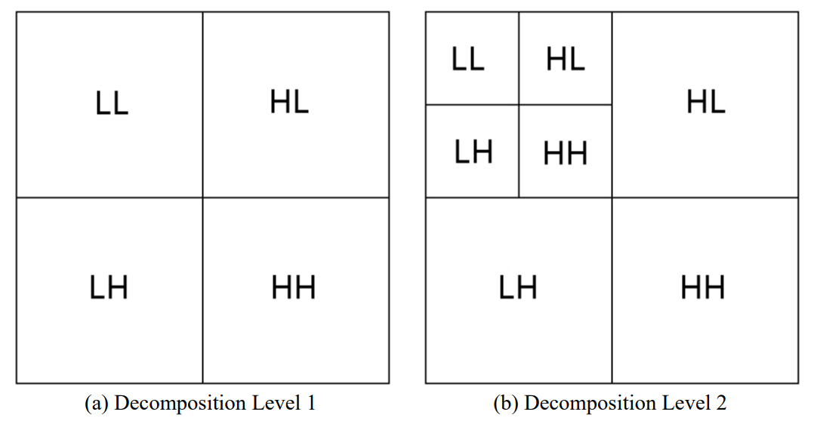
Wavelet Transform
Concept
In image processing, a wavelet transform (WT) is a mathematical technique that decomposes an image into different frequency components at different scales (multiresolution) to reveal both spatial and frequency attributes, useful for tasks like compression, denoising, and feature extraction.
Low Frequency (Approximation)
Image
Horizontal
High Frequency (Details)
Vertical
Diagonal

Slide 5
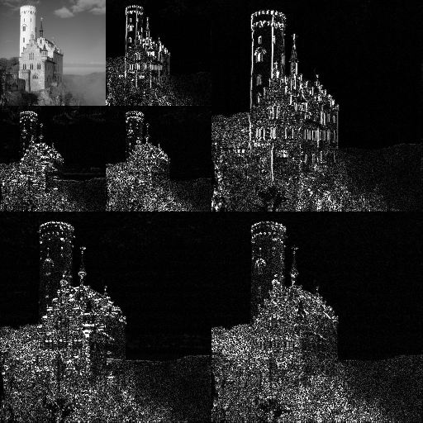
Wavelet Transform
Concept
In image processing, a wavelet transform (WT) is a mathematical technique that decomposes an image into different frequency components at different scales (multiresolution) to reveal both spatial and frequency attributes, useful for tasks like compression, denoising, and feature extraction.

Slide 6
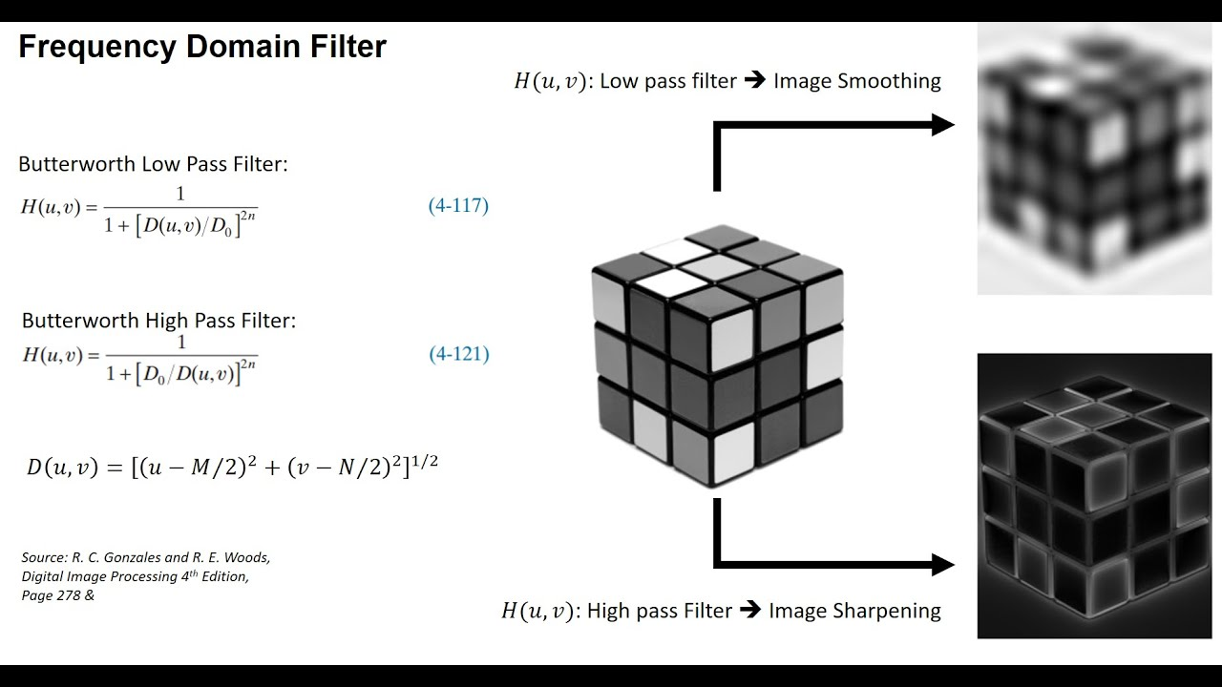
Wavelet Transform
Low-Pass and High-Pass Filters
- Low-pass filters allow low-frequency components to pass through while attenuating or removing high-frequency components. Applying a low-pass filter to an image results in a smoother image with reduced noise and less visible edges.
- High-pass filters allow high-frequency components to pass through while attenuating or removing low-frequency components. Applying a high-pass filter to an image enhances edges, fine details, and textures, making them more visible.

Slide 7
Wavelet Transform
Low-Pass and High-Pass Filters

Slide 8
Wavelet Transform
Why Wavelet?
- Multiresolution Analysis: Wavelet transforms allow for analyzing an image at different resolutions, capturing both fine details and broad structures
- Time-Frequency Localization: Unlike Fourier transform, which provide global frequency information, wavelet transforms offer localized time-frequency analysis, meaning they can identify features that vary over different scales.

Slide 9
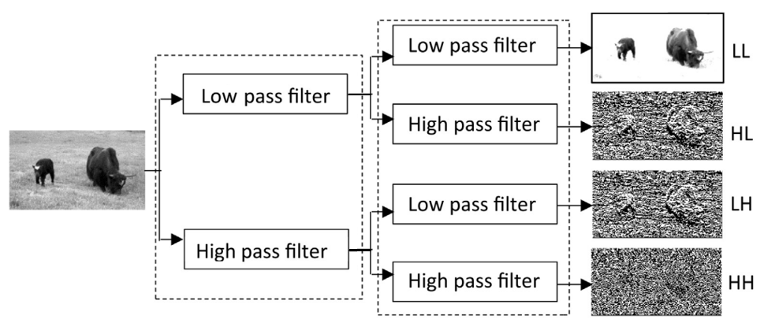
Wavelet Transform
Discrete Wavelet Transform (DWT)
Ref: https://www.sciencedirect.com/science/article/pii/S2314728817300508

Slide 10
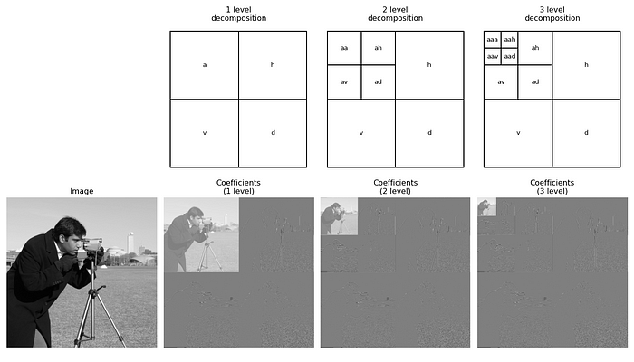
Wavelet Transform
Discrete Wavelet Transform (DWT)

Slide 11

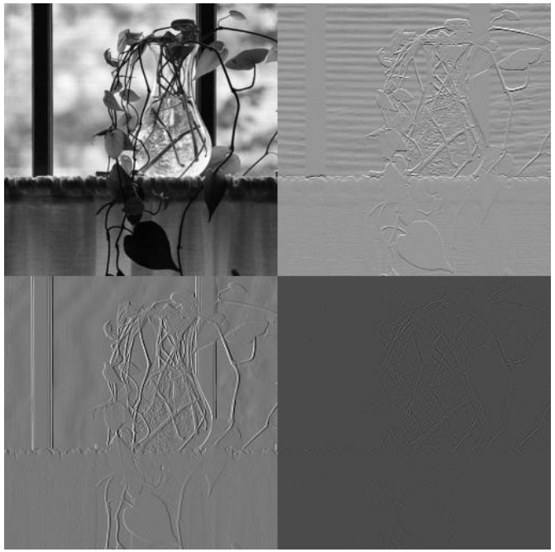
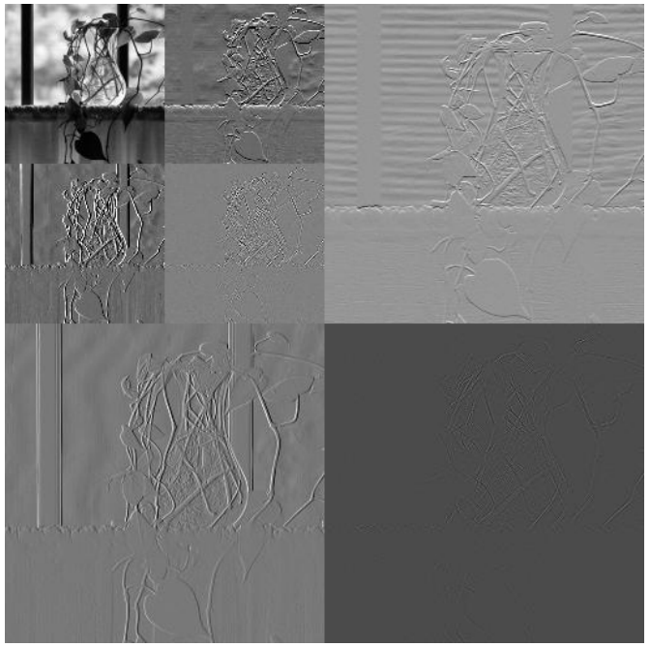
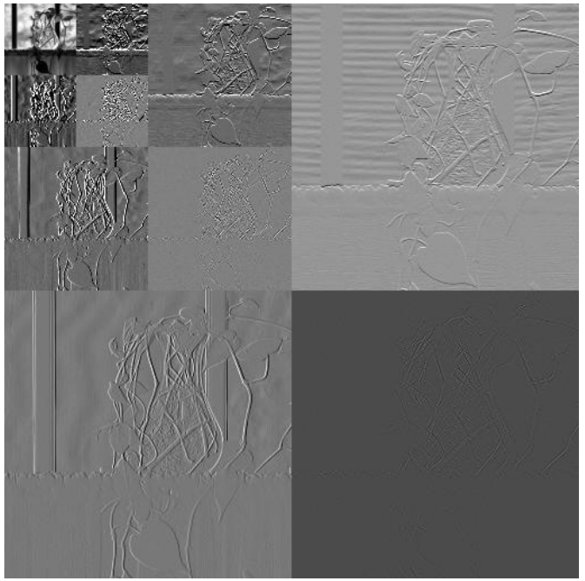
Wavelet Transform
Original
Haar Wavelet Transform (HWT)
Level 1
Level 2
Level 3
Ref: https://uotechnology.edu.iq/ce/Lectures/Image_Processing_4th/DIP_Lecture8.pdf

Slide 12
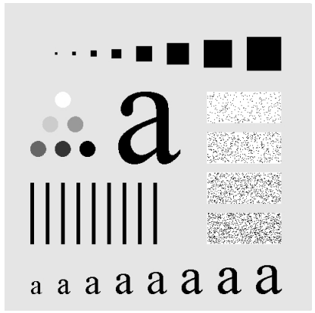
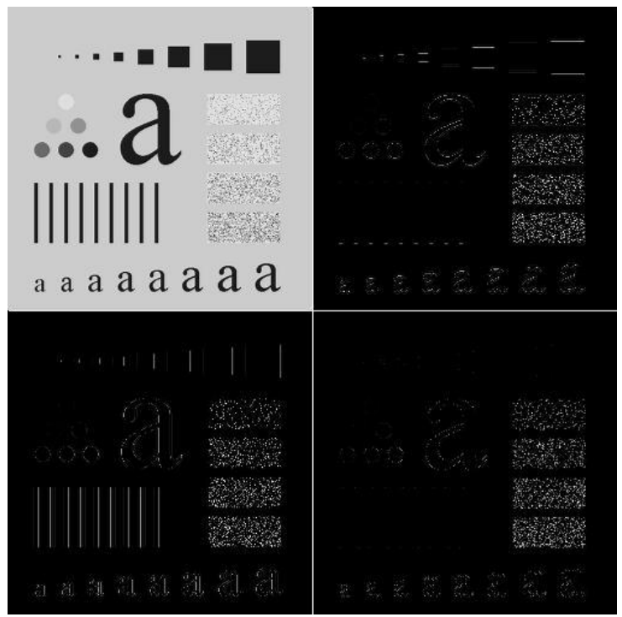
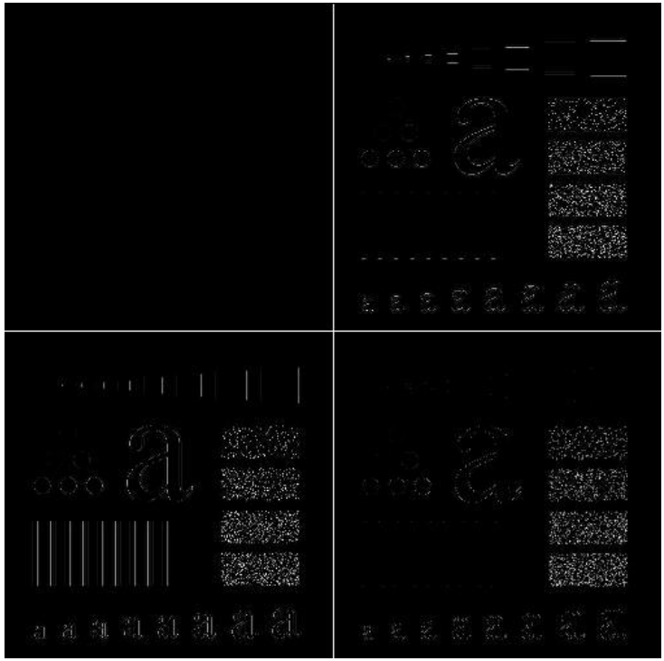
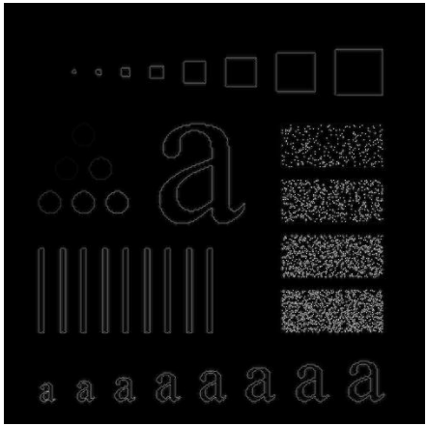
Wavelet Transform
Applications
Edge Detection
Original
Wavelet Transform
Zero the LL Subband
Resulted Edge Image
Ref: https://uotechnology.edu.iq/ce/Lectures/Image_Processing_4th/DIP_Lecture8.pdf

Slide 13
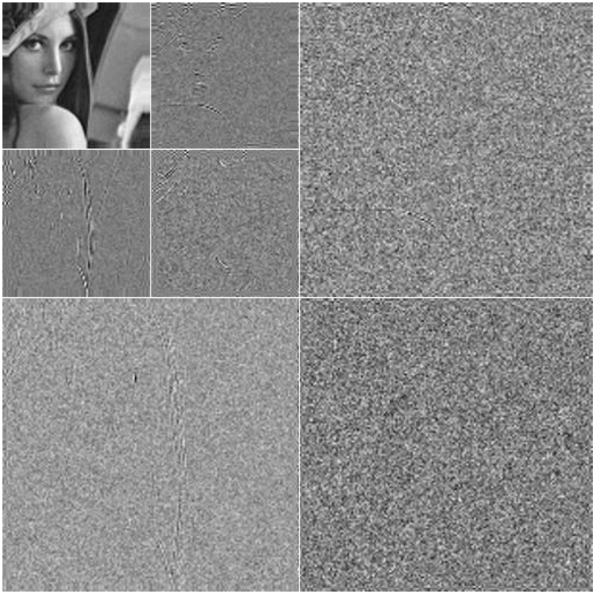
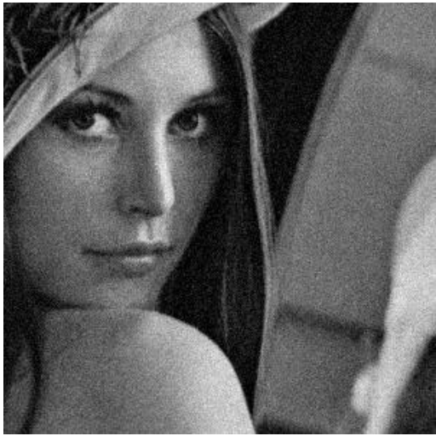
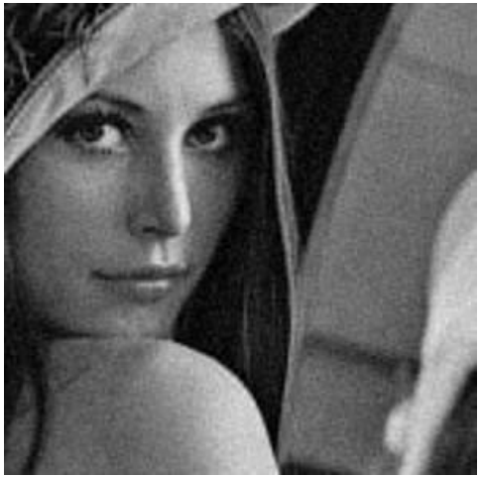
Wavelet Transform
Applications
Noise Reduction
Two-level Wavelet Transform
Zero the non-LL Subbands & Restore
Original
Noise Reduction / Loss of quality at the image edges.
Ref: https://uotechnology.edu.iq/ce/Lectures/Image_Processing_4th/DIP_Lecture8.pdf

Slide 14
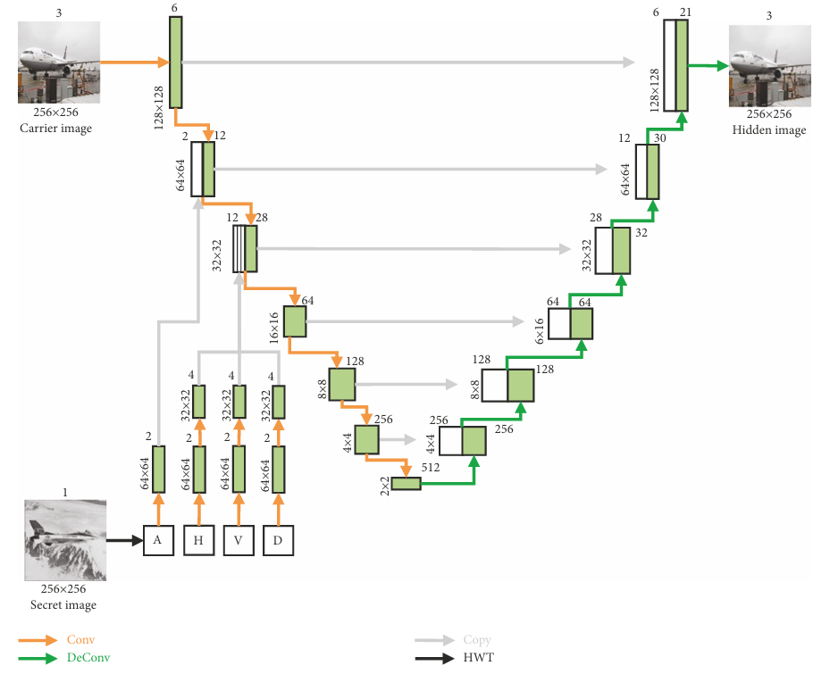
Wavelet Transform
Applications
Feature Extraction
Wavelet transforms can be used to extract important features to improve neural network’s performance.
Ref: https://onlinelibrary.wiley.com/doi/full/10.1155/2022/4345494

Slide 15
Wavelet Transform
Geometric Transformations

Slide 16
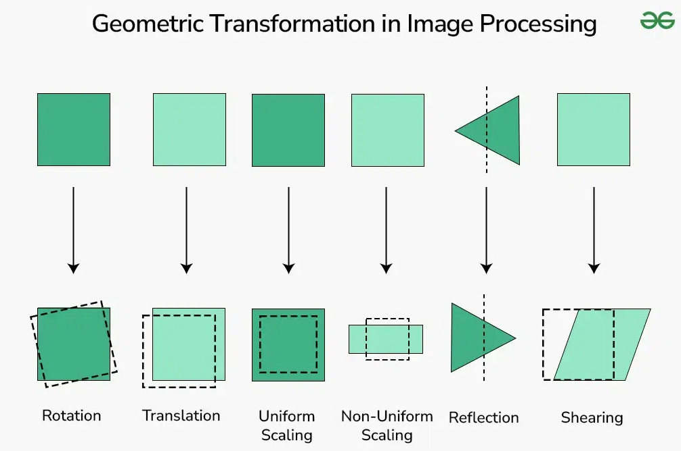
Geometric Transformations
Concept
Geometric Transformations in image processing involve altering an image's geometry by manipulating its pixels based on mathematical operations, such as translations, rotations, scaling, and shearing. These transformations are used to modify an image's position, size, rotation, or shape
Ref: https://www.geeksforgeeks.org/geometric-transformation-in-image-processing-1/

Slide 17
Geometric Transformations
Examples
- Translation
- Scaling
- Rotation
- Shearing (Skewing)
- Affine Transformation
- Perspective Transformation
Ref: https://www.geeksforgeeks.org/geometric-transformation-in-image-processing-1/

Slide 18
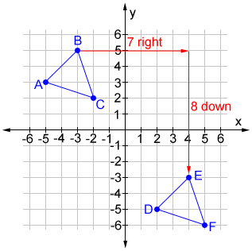
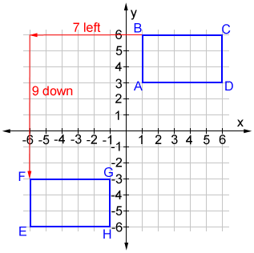
Geometric Transformations
Translation
- Shifting an image in a specific direction (horizontally and/or vertically).
- This transformation moves every pixel by a constant offset.

Slide 19
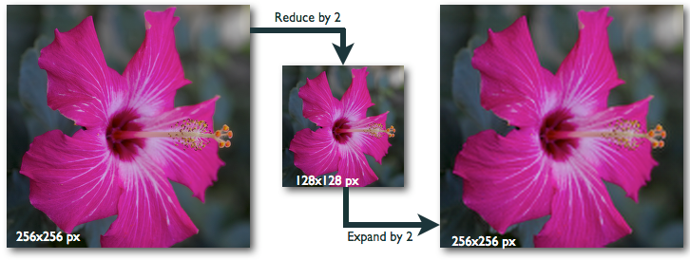
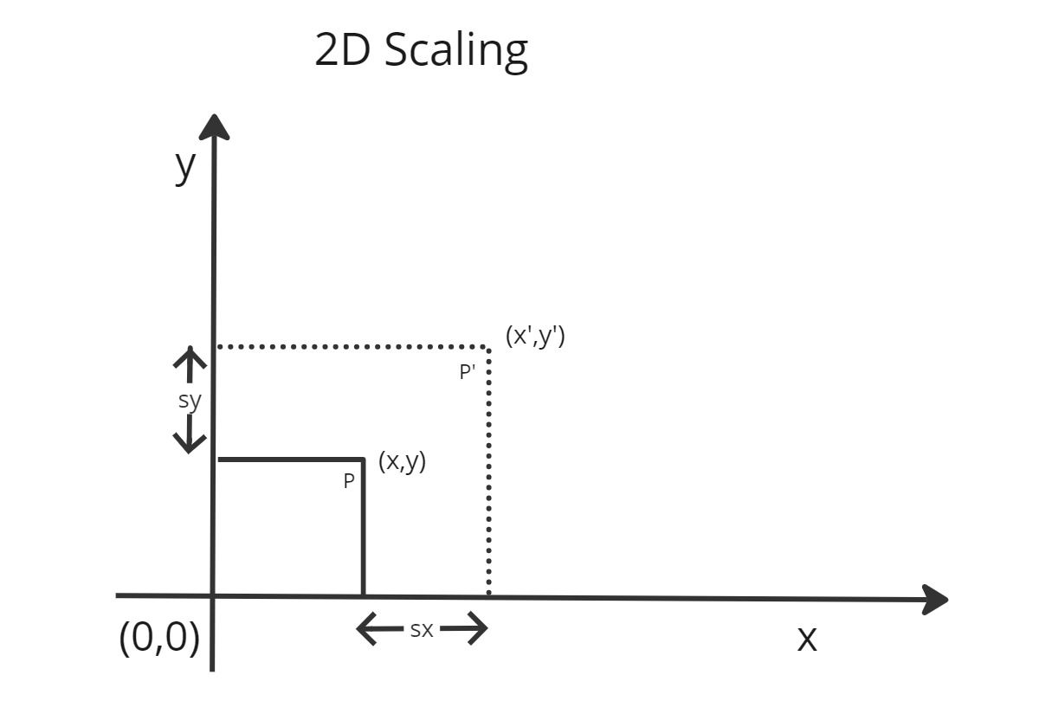
Geometric Transformations
Scaling
- Changing the size of an image (enlarging or reducing).
- This involves multiplying pixel coordinates by scaling factors.

Slide 20
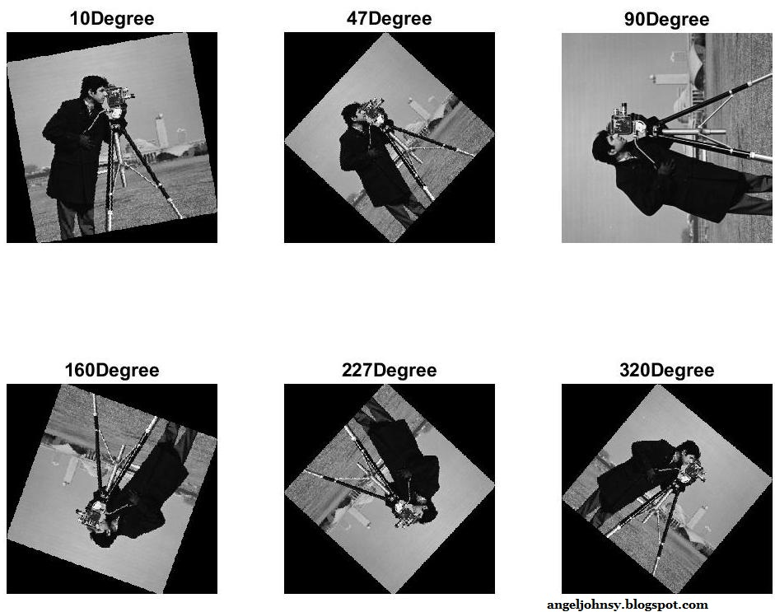
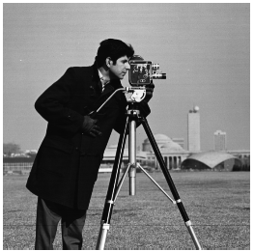
Geometric Transformations
Rotation
- Turning an image around a specific point.
- This transformation involves rotating pixel coordinates by a certain angle.
Original

Slide 21
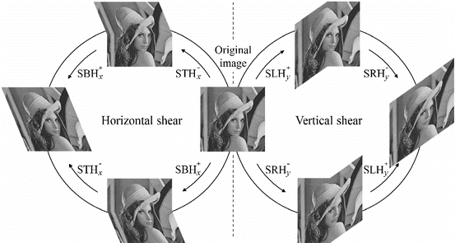
Geometric Transformations
Shearing (Skewing)
- Distorting an image by shifting pixels along one axis.
- This transformation skews the image.

Slide 22
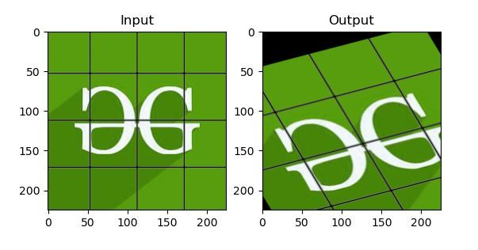
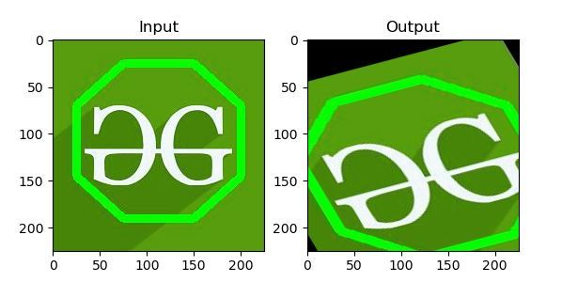
Geometric Transformations
Affine Transformation
- A combination of translation, scaling, rotation, and shearing.
- Preserves parallel lines.
Ref: https://www.geeksforgeeks.org/python-opencv-affine-transformation/

Slide 23
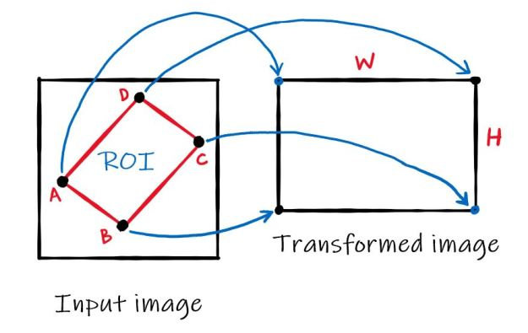
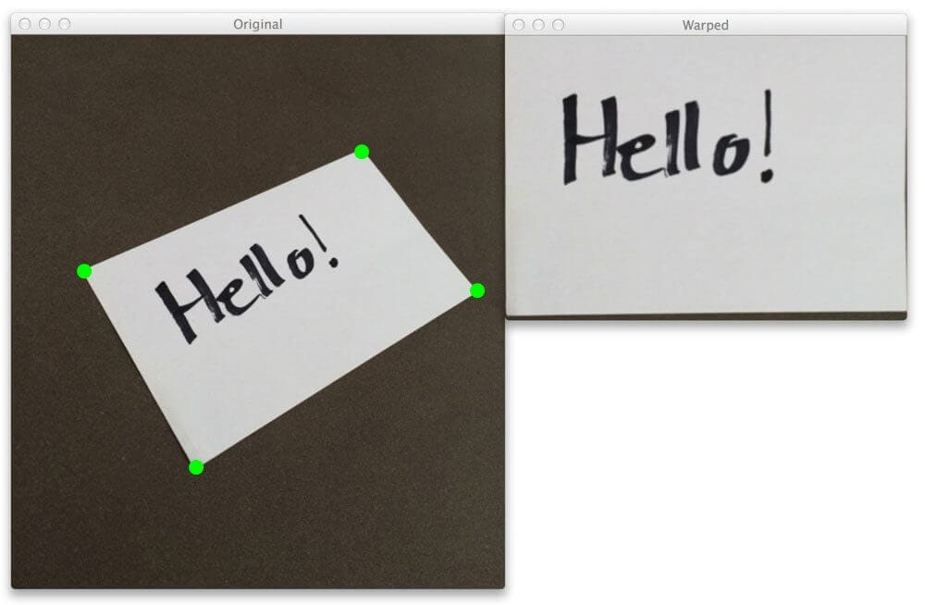
Geometric Transformations
Perspective Transformation
- More complex transformations that can change the perspective of an image.
- Used for correcting perspective distortions.

Slide 24
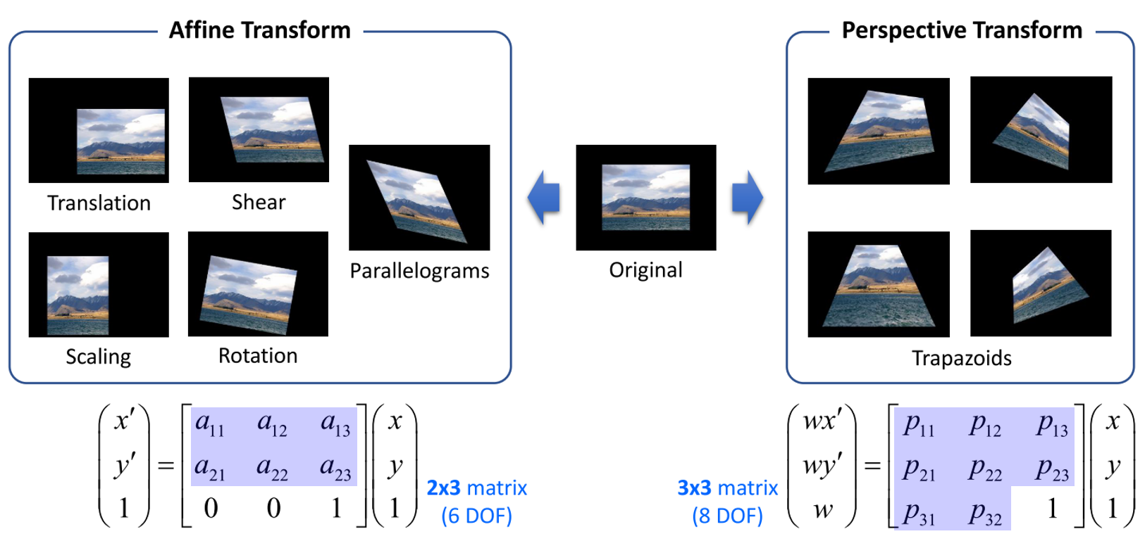
Geometric Transformations
Affine Transformation vs Perspective Transformation
Ref: https://gaussian37.github.io/vision-concept-image_transformation/

Slide 25
Wavelet Transform & Geometric Transformations
Practice
- Wavelet Transform
- Geometric Transformations

Slide 26
Thank You
anhtl@ut.edu.vn

